Slide 1
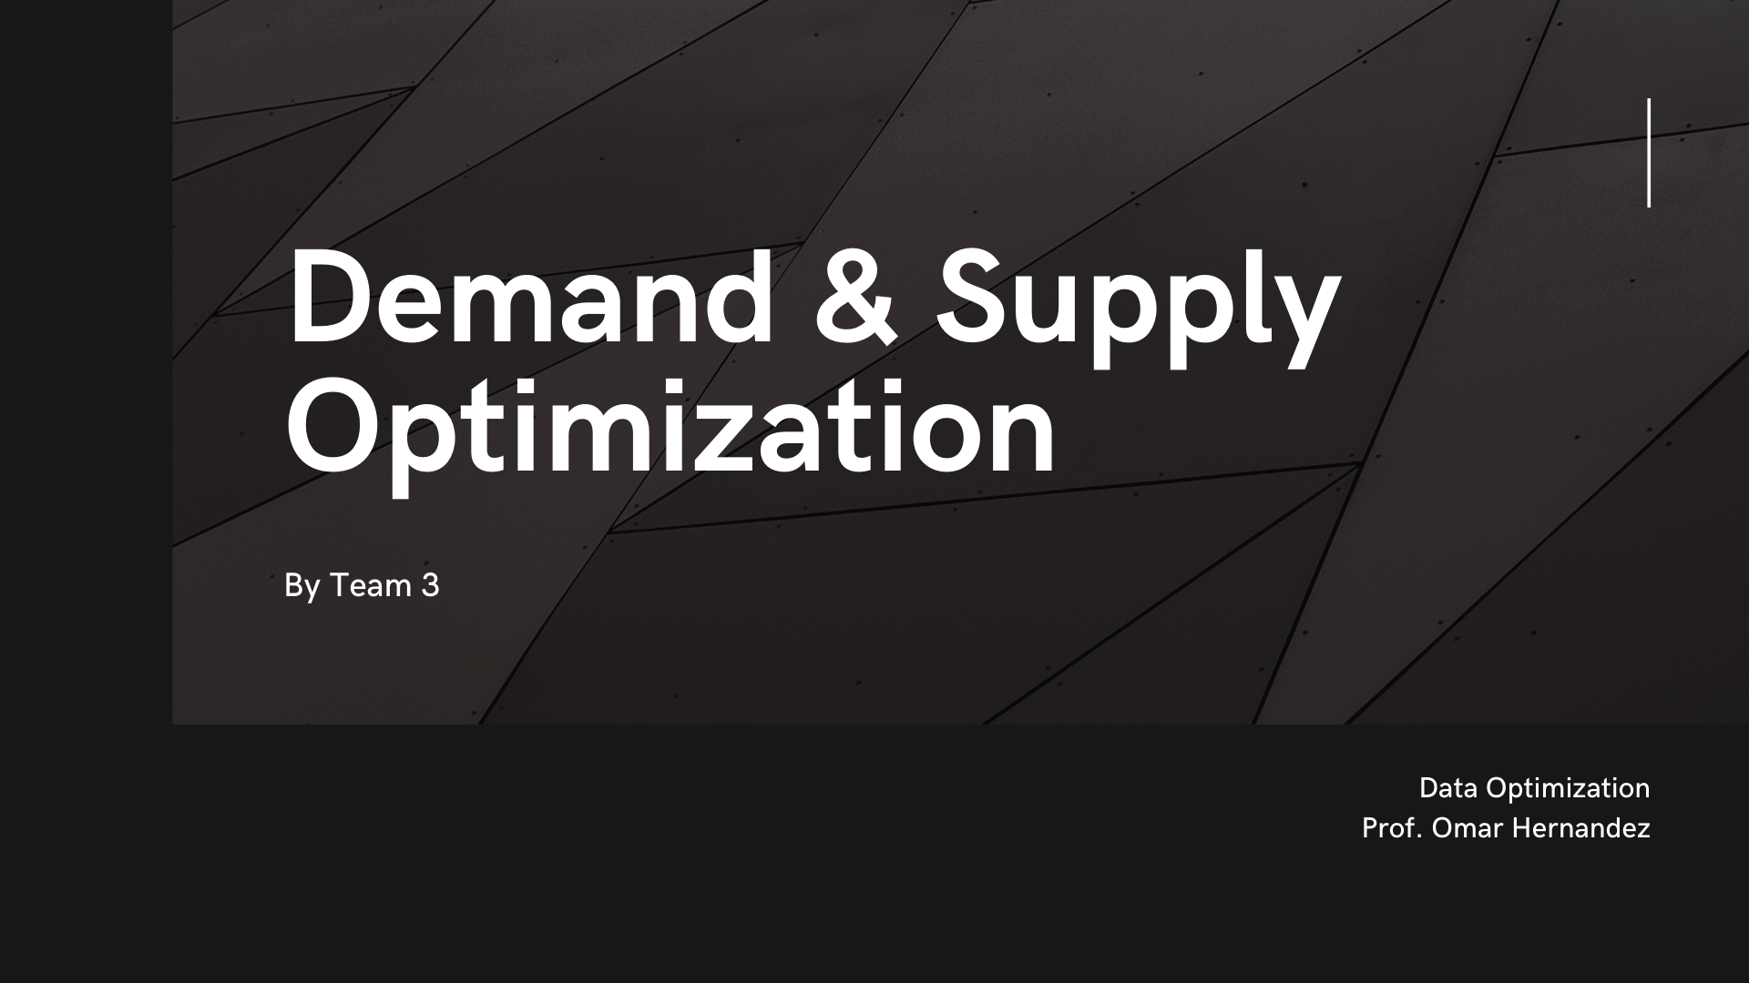
Notes:
Introduction

Slide 2
COMPANY PROFILE
RCI is Santa Monica based company, operating in the cosmetics industry mainly skin care. Their business model consists of using loyalty and subscription-based E-Commerce model. They have 3 Flagship products, with annual revenue of 150$ Millions. With an in-house production line, they are looking to grow in the cost - effective model in the fast-growing lucrative market.

Slide 3

MODEL objective
Solving for minimization of cost and/or a key decision to make or buy for production to match excessive demand using linear programming model.

Slide 4
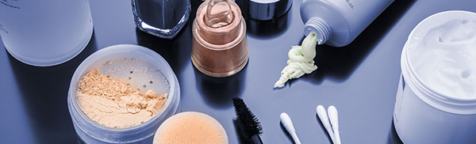
PROBLEM STATEMENT
RCI is planning their production schedule for the upcoming quarter and due to shortage in internal capacity they are looking to outsource some part of the demand to an external party.
Their previous policies advise against outsourcing, however, supply key ingredients to the vendor to maintain privacy of the in-house process e.g., water-oil solutions.
We are looking at possible local suppliers or vendors to meet demand in the future but also make or buy decision for production of critical sub-components.

Slide 5
CONSTRAINTS
Hourly rates and shifts
Cost of raw materials
Available capacity in-house
Inventory hold-up (Storage)
Binary variables
(0- In Source)
(1- Out Source)

Slide 6
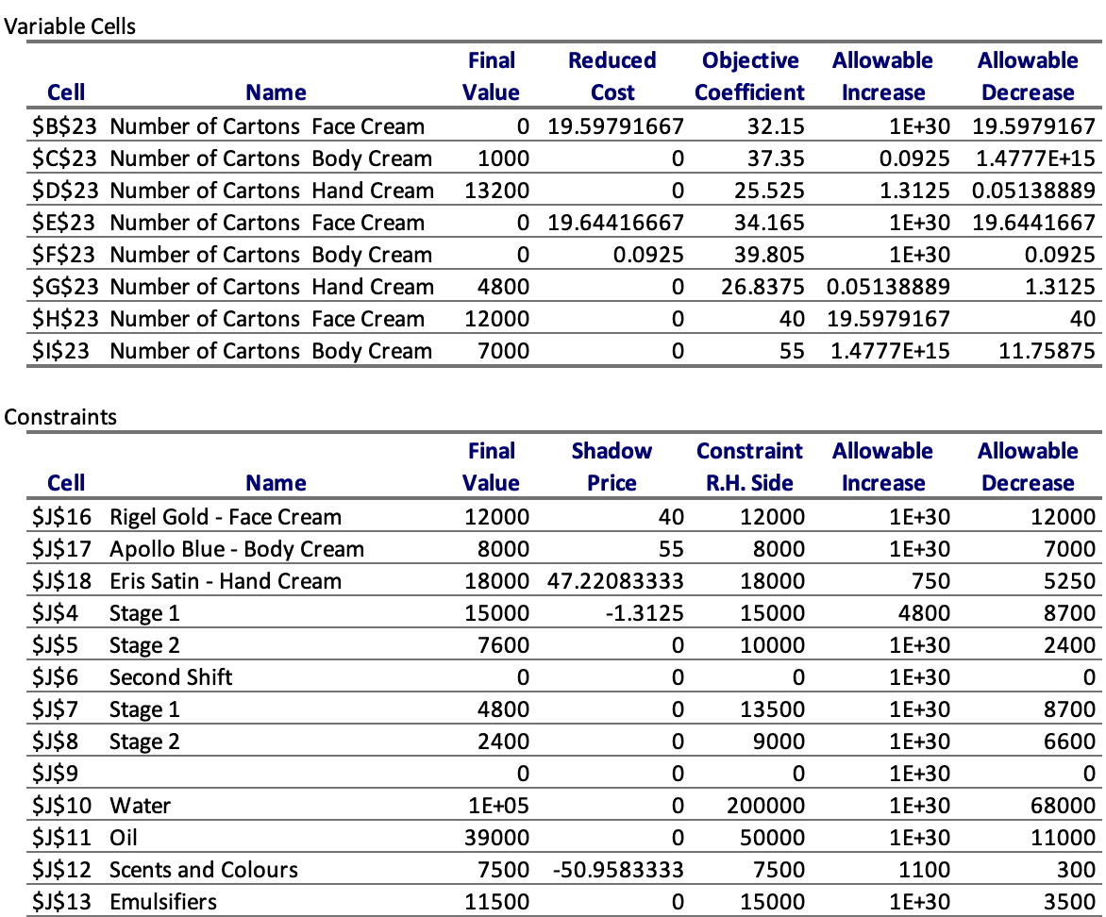
Model Sensitivity Analysis
If we produce one additional unit ( increase the RHS constraint) with Rigel Gold face cream, we will have to pay 40$ additional for those resources associated with it.
Reduced cost predicted in the model is sufficient, but it can be improved or reduced in case of minimization in this problem.
For the scent & colors if we manage the negative shadow price or corresponding slack or -50.95, we could use this savings in another ingredient.

Slide 7
Key Findings
*Insights generated from answer report in excel
Cartons of face cream to make in first shift = 0
Cartons of body cream to make in first shift = 1000
Cartons of hand cream to make in first shift = 13200
Cartons of face cream to make in second shift = 0
Cartons of body cream to make in second shift = 0
Cartons of hand cream to make in second shift = 4800
Cartons of face cream to outsource = 12000
Cartons of body cream to outsource = 7000
Value of objective function (total cost) = $ 1,368,100

Slide 8
Recommendations
Analyzing the optimization model, we recommend that
RCI should consider third party vendor help to increase production to match the demand.
Outsource partially the face cream and the body cream .
Mainly maintain heavy secrecy or control over components that they outsource.
Risks –
Lose out on Demand.
Partially reveal secret ingredients used in the production.
Risk Control –
Optimize supply chain separate for sub-components from third party vs internal.
Enhanced high skilled labor in areas of high value ingredient production sources to maintain tight control.
Have a pre-existing exit strategy in-case of a leak or vendor information breach to protect the ingredient

Slide 9
Appendix

Slide 10
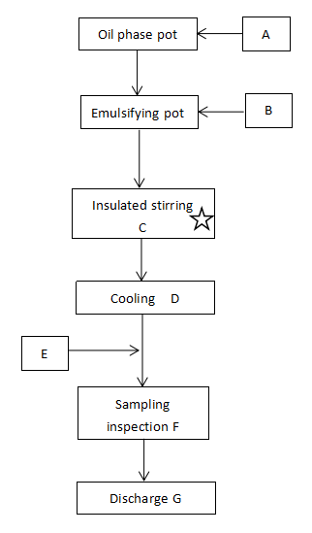
Process Flow Chart
Flow chart for production of Hand & Face Cream
https://www.lmzhotelamenites.com/info/production-flow-chart-body-lotion-hand-body-l-33177025.html

Slide 11
Cosmetic & Beauty Products Manufacturing in the US
Size (US) | $40.9bn in 2021
Labor | There are 52,423 people employed in the Cosmetic & Beauty Products Manufacturing industry in the US as of 2021.
Growth | 5.6% growth in 2021
Investment opportunity for Rougir | Research and Development (As public and private R&D funding grows, industry operators will likely have better access to advanced ingredients and methodologies for producing cutting-edge product)
Threats | 30% of the beauty industry market was closed due to covid-19

Slide 12
References
BISWorld - Industry Market Research, Reports, and Statistics. (2020). Retrieved 18 March 2021, from https://www.ibisworld.com/industry-statistics/market-size/cosmetic-beauty-products-manufacturing-united-states/
Production flow Chart Body Lotion/Hand& body lotion. (n.d.). Retrieved March 20, 2021, from
https://www.lmzhotelamenites.com/info/production-flow-chart-body-lotion-hand-body-l-33177025.html
Bodily, S., Bodily, S., Ovchinnikov, A., Edelman, B., Edelman, B., Webster, K., . . . Hammond, J. (n.d.). Rougir cosmetics international: Production optimization ^ W17541. Retrieved March 20, 2021, from https://store.hbr.org/product/rougir-cosmetics-international-production-optimization/W17541

